Slide 1
CMP2060M Database Systems Assessment Item 1 Presentation
Group 33
Brandon Slater (20%), Daniel Dixon (20%), Edd Pidd (20%), Joshua Moore (20%), Matt Seelig (20%)

Slide 2
Appraisal and Analysis

Slide 3
System Functional Analysis
Customer -> Online System -> Order Product/s
Company -> Supplies Products -> Customer -> Providing Invoice
Products not in Stock -> Purchase order raised -> Buy From Third Party Supplier
Feedback From Company -> Customer

Slide 4
Reasonable Assumptions
The whole purchasing process takes place online​
The customer must follow a Sign up / Login Process to access the system​
The customer will have to sign up before being able to login​
The customer logs in to purchase a product​
The company only restocks when fully empty of the product​
Relevant services are based on products purchased​
All information stored is done so as securely as possible​
All relevant discounts are applied automatically and the customer does not need to know a code or have a voucher in their possession​
Customer card details are not stored and need to be entered every time a purchase is made​
The invoice is created using the customer order, and therefore is not an entity.​
The Third Party Supplier And Supplier can be classed as the same entity type.​​

Slide 5
Company Requirements
Functional Requirements:
1) Store customer, supplier and staff information​
2) Store order information​
3) Receive payment from the customer​
4) Create an invoice for the customer and send it to them once the product is paid for​
5) Order must be accessible (garden department) ​
6) A request for Customer Feedback​
7) Order stock from third-party suppliers​

Slide 6
Customer Requirements
Functional Requirements:
1) Place an order for a specific item​
2) Have their information stored securely​
3) Have the correct items shipped on time​
4) Receive an invoice for their purchase ​
5) Receive plant care instructions with the order

Slide 7
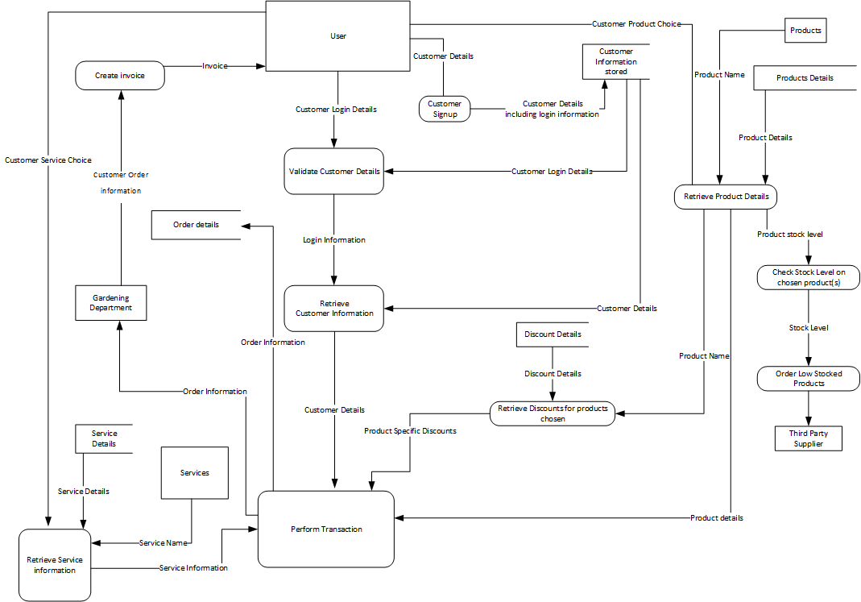
Data Flow Diagram

Slide 8
Entities, Attributes, Relationships, Initial Conceptual design, Preliminary Design of Entity Types and Preliminary Design of Relationship Types

Slide 9
Identifying Entities

Slide 10
Identifying the Nouns from the Brief
Lincoln garden centre, Company, Lincolnshire, Plants, Accessories, Services, Customers.​
​
Customers, Order, Company, item, Flower Bouquet, Garden Pots, Customer Order, Customers Name, Delivery Address, Billing Address, Items ordered, Quantity, Order date, Order status(Eg. Pending, Confirmed, Dispatched, paid), Total price, Date, Order, date the order was Dispatched, Date the invoice was sent to the customer, date payment was received, Customer Order, Price by item, How many required, Discount, total price by item.​
​
Customer Order, Invoice, Customer, customer, invoice, Customer order, garden department, ordered items, customer, Paid Invoice, ,Plant Care Instructions, Customer Feedback.​
​
Standard Stock Items, Out of Stock, Purchase Order, Third Party Supplier, Suppliers Name, Suppliers address, Stock item description, Stock Item Quantity, Order Date, Order status( Pending, sent, received, Paid), Total Cost, Date the order was received, Date the payment was sent, Purchase order, supplier, Stock items, LGC, Garden Center.​
​
Stock Items(flower, Plant) Information, The Stock Items (flower, plant) information should include (at least): Latin name, Popular Name, Plant attributes (such as colour of foliage, colour of flowers, flowering period, height and spread for example, etc.), plant category (Shrub, tree, climber), Season of Interest (Any, Spring, Summer, Autumn, Winter), Full description, How to grow (Soil type, Moisture, Acid or Alkaline, sunlight {Full sun, half shade,} etc.) and Aftercare.​
​
Customer Orders, Purchase orders, LGC Ordering System, Store information( EMail, address, Name), Customers, Staff​

Slide 11
Identifying the Entities
Lincoln garden centre, Company, Lincolnshire, Plants, Accessories, Services, Customers.​
​
Customers, Order, Company, item, Flower Bouquet, Garden Pots, Customer Order, Customers Name, Delivery Address, Billing Address, Items ordered, Quantity, Order date, Order status(Eg. Pending, Confirmed, Dispatched, paid), Total price, Date, Order, date the order was Dispatched, Date the invoice was sent to the customer, date payment was received, Customer Order, Price by item, How many required, Discount, total price by item.​
​
Customer Order, Invoice, Customer, customer, invoice, Customer order, garden department, ordered items, customer, Paid Invoice, ,Plant Care Instructions, Customer Feedback.​
​
Standard Stock Items, Out of Stock, Purchase Order, Third Party Supplier, Suppliers Name, Suppliers address, Stock item description, Stock Item Quantity, Order Date, Order status( Pending, sent, received, Paid), Total Cost, Date the order was received, Date the payment was sent, Purchase order, supplier, Stock items, LGC, Garden Center.​
​
Stock Items(flower, Plant) Information, The Stock Items (flower, plant) information should include (at least): Latin name, Popular Name, Plant attributes (such as colour of foliage, colour of flowers, flowering period, height and spread for example, etc.), plant category (Shrub, tree, climber), Season of Interest (Any, Spring, Summer, Autumn, Winter), Full description, How to grow (Soil type, Moisture, Acid or Alkaline, sunlight {Full sun, half shade,} etc.) and Aftercare.​
​
Customer Orders, Purchase orders, LGC Ordering System, Store information( EMail, address, Name), Customers, Staff​

Slide 12
Attributes

Slide 13
Identifying the Attributes from the Entities
Entities​ | Attributes​
Service​ | Name, Due Date, Price
Customer​ | First Name, Surname, Email Address, Delivery Address & Billing Address.​
Plant​ | Latin name, Popular Name, Price, Plant attributes (colour of foliage, colour of flowers, flowering period, height, spread), Plant category, Season of Interest, Full description, How to grow (Soil type, Moisture, Acid or Alkaline, sunlight etc.), Aftercare.​
Accessory​ | Name, Full description, Price.​
Customer Order​ | Items (the item(s) ordered, the quantity of each item ordered, Price of each item ordered), Order Total, Order Placement Time, Order Placement Date, Order Status, Order Arrival Date.​
Department​ | Name.​
Purchase Order​ | Items required, Quantity required, Price by item, Order Total, Order date, Order status, Order Arrival Date, Total cost, Date payment sent.​
Third Party Supplier​ | Name, Address.​
Staff​ | First Name, Surname, Email Address & Address.​

Slide 14
Relationships

Slide 15
Identifying Relationships
Relationships From the brief:​
1) Customer Places Order​
3) Customer Order Controlled by department ​
4) Feedback from customer about Order ​
5) Purchase Order sent to Supplier​
6) Customer Order contains Plants, ​Services & Or Accessories​
Implied Relationships:​
1) Department has staff​
2) Department Stocks Plants & Accessoires​
3) Department Provides the Services​

Slide 16
Initial Conceptual design

Slide 17
Initial Design 1/2
Entities​ | Attributes​
Service​ | Service is a strong entity with the attributes: Name, Due Date, Price. All of the attributes are single valued. Name is the Primary Key.​
Customer​ | Customer is a strong entity with the attributes: Name(First Name, Surname), Email Address, Delivery Address & Billing Address(Postcode, Street Name, Town, House No). Name and Address are composite attributes. Email address is single valued and the primary key.​
Plant​ | Plant is a strong entity with the attributes: Name(Latin name, Popular Name), Price, Plant attributes (colour of foliage, colour of flowers, flowering period, height, spread), Plant category, Season of Interest, Full description, How to grow (Soil type, Moisture, Acid or Alkaline, sunlight etc.). Name, Plant attributes and how to grow are composite attributes, Price, plant category, season of interest and full description are single valued attributes. Popular Name is the primary key.​
Accessory​ | Accessory is a strong entity with the attributes: Name, Full description, Price. All single valued attributes with Name being the primary key.​
Customer Order​ | Customer Order is a weak entity of Customer with attributes: [Order Total], Order Placement Time, Order Placement Date, Order Status, Order Arrival Date. Order Total is a derived attribute, Order Placement Time, Order Placement date, order status and order arrival date are all single attributes. Order placement date and order placement time are partial keys.​

Slide 18
Initial Design 2/2
Entities​ | Attributes​
Department​ | Department is a strong entity with the attribute: Name. Name is a single stored attribute and is the primary key.​
Purchase Order​ | Purchase Order is a weak entity of the Third Party Supplier and has attributes: Purchase Order Items({Items required}, {Quantity required}, {Price Per item}), [Order Total], Order Time, Order date, Order status, Order Arrival Date, Date payment sent. Purchase order items is a composite attribute including three multi valued attributes. Order total is a derived attribute, and all other attributes are single stored. Order Time and Order Date are the partial keys.​
Third Party Supplier​ | The third party supplier is a strong entity and has the attributes: Name, Address(Town, Postcode, Street). Name is the single attribute and the primary key. Address is a composite attribute.​
Staff​ | Name(First Name, Surname), Email Address, Address(Postcode, Street Name, Town, House No). Email Address is the primary key, Name and Address are composite attributes.​

Slide 19
Preliminary Design of Entity Types

Slide 20
Preliminary design of entity types:​
Customer:
-- Name(First Name, Surname), Email Address, Delivery Address & Billing Address(Postcode, Street Name, Town, House No).
Customer Order:​
--- Order Placement Time, Order Placement Date,[Order Total], Order Status, Order Arrival Date. ​
Servies:
-- Name, Due Date, Price. ​
Accessories:
-- Name, Due Date, Price. ​
Plants:
-- Name(Latin name, Popular Name), Price, Plant attributes (colour of foliage, colour of flowers, flowering period, height, spread), Plant category, Season of Interest, Full description, How to grow (Soil type, Moisture, Acid or Alkaline, sunlight etc.). ​
Department:​
-- Name​
Purchase Order:​
-- Order Time, Order date, Purchase Order Items({Items required}, {Quantity required}, {Price Per item}), [Order Total], Order status, Order Arrival Date, Date payment sent.​
Staff:
-- Name(First Name, Surname), Email Address, Address(Postcode, Street Name, Town, House No).​
Third Party Supplier:
-- Name, Address(Town, Postcode, Street).​

Slide 21
Preliminary Design of Relationship Types

Slide 22
Relationship Type Preliminary Design
Customer places Customer Order (1:M) -​
Some Customers are involved in this relationship​
All Customer Orders are involved in this relationship​
Department Controls Customer Order(1:M) -​
Some Departments are involved in the relationship​
All Customer Orders are involved in the relationship​
Customer gives feedback on customer order (1:M)​
Some Customers are involved in this relationship​
Some Customer orders are involved in this relationship.​
Department Has Staff(1:M)​
All Departments are involved in this relationship​
All Staff are involved in this relationship.​
Department Stocks Plants(1:M)​
Some Departments are involved in this relationship.​
All Plants are involved in this relationship.
Department Stocks Accessories (1:M)​
Some Departments are involved in this relationship.​
All Accessories are involved in this relationship.​
Department Provides Services (1:M)​
Some Department are involved in this relationship.​
All Services are involved in this relationship.​
Customer Order Includes Plants (M:N)​​
Some Customer Orders are involved in this relationship.​
Some Plants are involved in this relationship.​
Customer Order Includes Accessories (M:N)​​
Some Customer Order are involved in this relationship.​
Some Accessories are involved in this relationship.​
Customer Order Includes Services (M:N)​​
Some Customer Order are involved in this relationship.​
Some Services are involved in this relationship.​
Purchase Order Sent To Third Party Supplier (M:N)​
All Purchase Order are involved in this relationship.​
Some Third Party Supplier are involved in this relationship.​

Slide 23
Relationships Constraints and Cardinality
Entity (Noun)​ | Cardinality​ | Constraints​ | Verb ​ | Cardinality​ | Constraints​ | Entity (Noun)​
Customer​ | 1​ | Partial​ | Orders​ | M​ | Total ​ | Customer Order​
Department​ | 1​ | Partial​ | Controls​ | M​ | Total​ | Customer Order​
Customer​ | 1​ | Partial​ | Feedback​ | M​ | Partial​ | Customer Order​
Department ​ | 1​ | Total​ | Has​ | M​ | Total​ | Staff​
Department​ | 1​ | Partial​ | Stock​ | M​ | Total​ | Plants​
Department ​ | 1​ | Partial​ | Stock​ | M​ | Total​ | Accessories​
Department​ | 1​ | Partial​ | Provides​ | M​ | Total​ | Services​
Customer Order​ | M​ | Partial​ | Includes​ | N​ | Partial​ | Plants​
Customer Order​ | M​ | Partial​ | Includes​ | N​ | Partial​ | Accessories​
Customer Order​ | M​ | Partial​ | Includes​ | N​ | Partial​ | Services​
Purchase Order​ | M​ | Total​ | Sent​ | N​ | Partial​ | Third Party Supplier​

Slide 24
ER Model

Slide 25
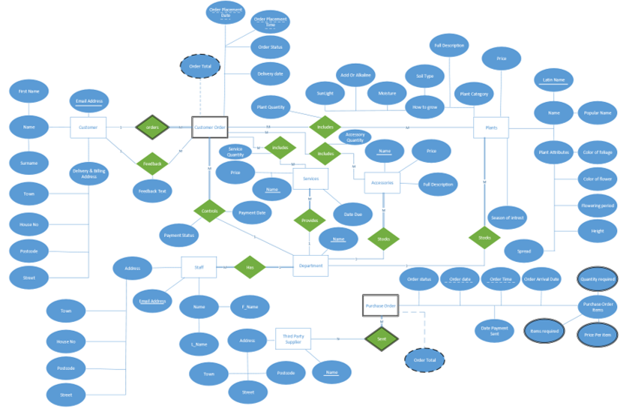
ER Model

Slide 26
ER model Mapping

Slide 27
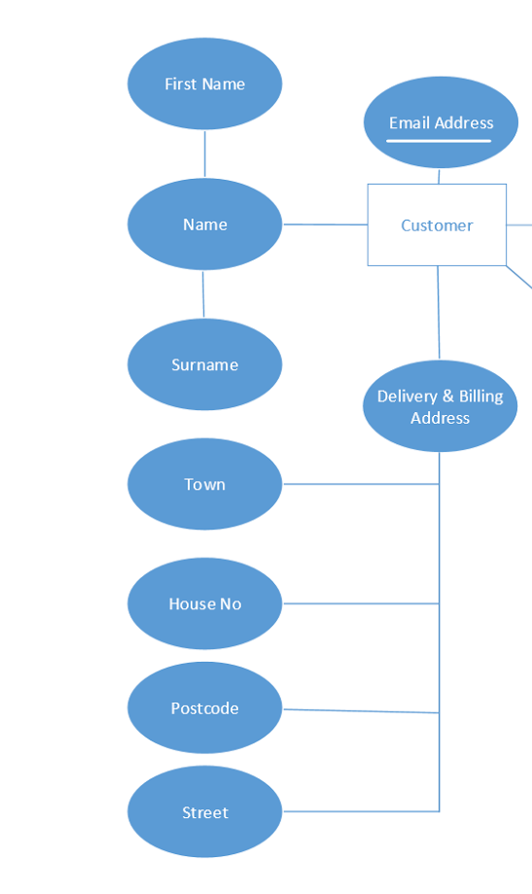
Mapping Step 1:
Mapping Of Strong Entities:
To Complete Step 1 of the mapping process, take the strong entities from the ER Diagram, along with the single, stored attributes and assign each entity a primary key.
Customer: Cus_EmailAddress, Cus_FirstName, Cus_Surname, Cus_Town,
Cus_HouseNo, Cus_PostCode, Cus_Street.

Slide 28
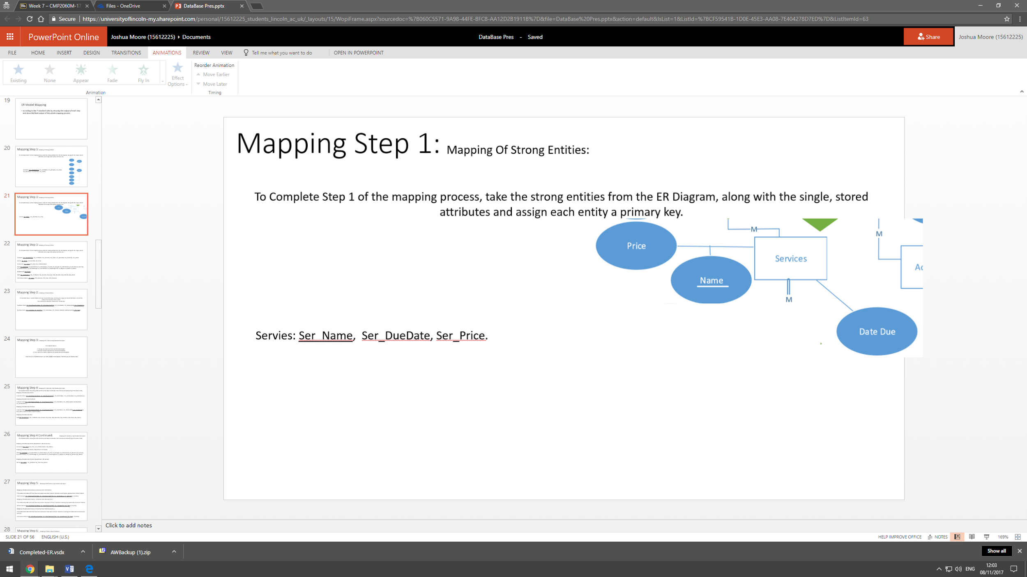
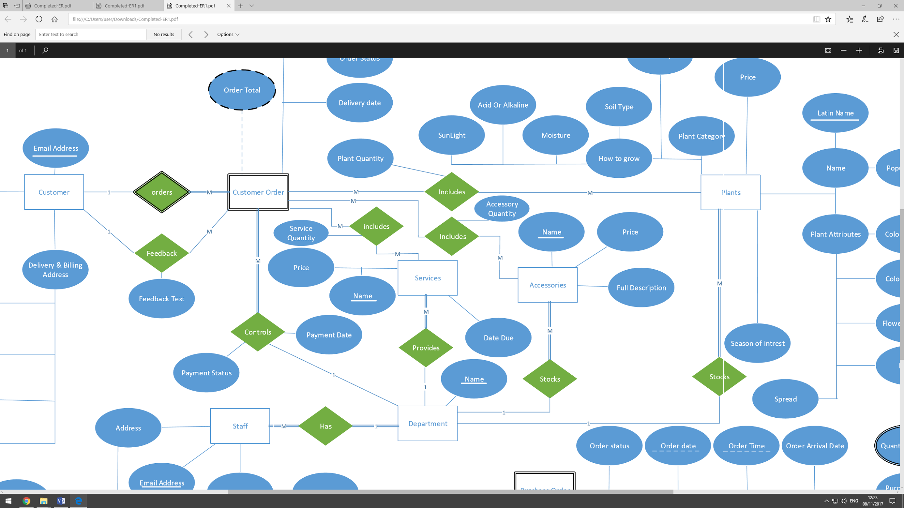
Mapping Step 1:
Mapping Of Strong Entities:
To Complete Step 1 of the mapping process, take the strong entities from the ER Diagram, along with the single, stored attributes and assign each entity a primary key.
Services: Ser_Name, Ser_DueDate, Ser_Price.
Accessories: Acc_Name,Acc_Price, Acc_FullDescription.

Slide 29
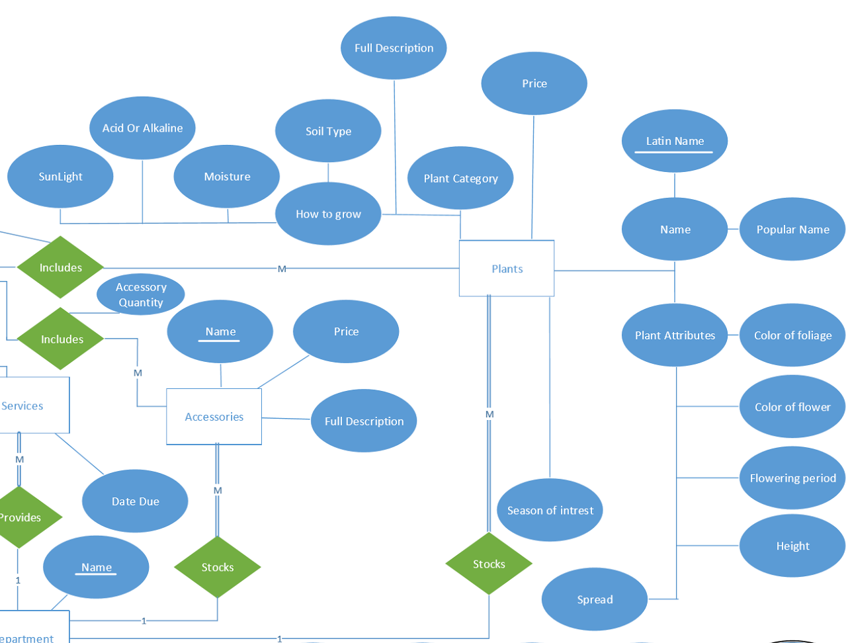
Mapping Step 1:
Mapping Of Strong Entities:
To Complete Step 1 of the mapping process, take the strong entities from the ER Diagram, along with the single, stored attributes and assign each entity a primary key.
Plant: Pl_LatinName, Pl_PopularName, Pl_PlantCategory, Pl_Price, Pl_SunLight, Pl_AcidOrAlkaline, Pl_Moisture,Pl_Soil Type, Pl_FullDescription, Pl_ColorOfFoliage, Pl_ColorOfFlower, Pl_FloweringPeriod, Pl_Height, Pl_Spread, Pl_Spread.

Slide 30
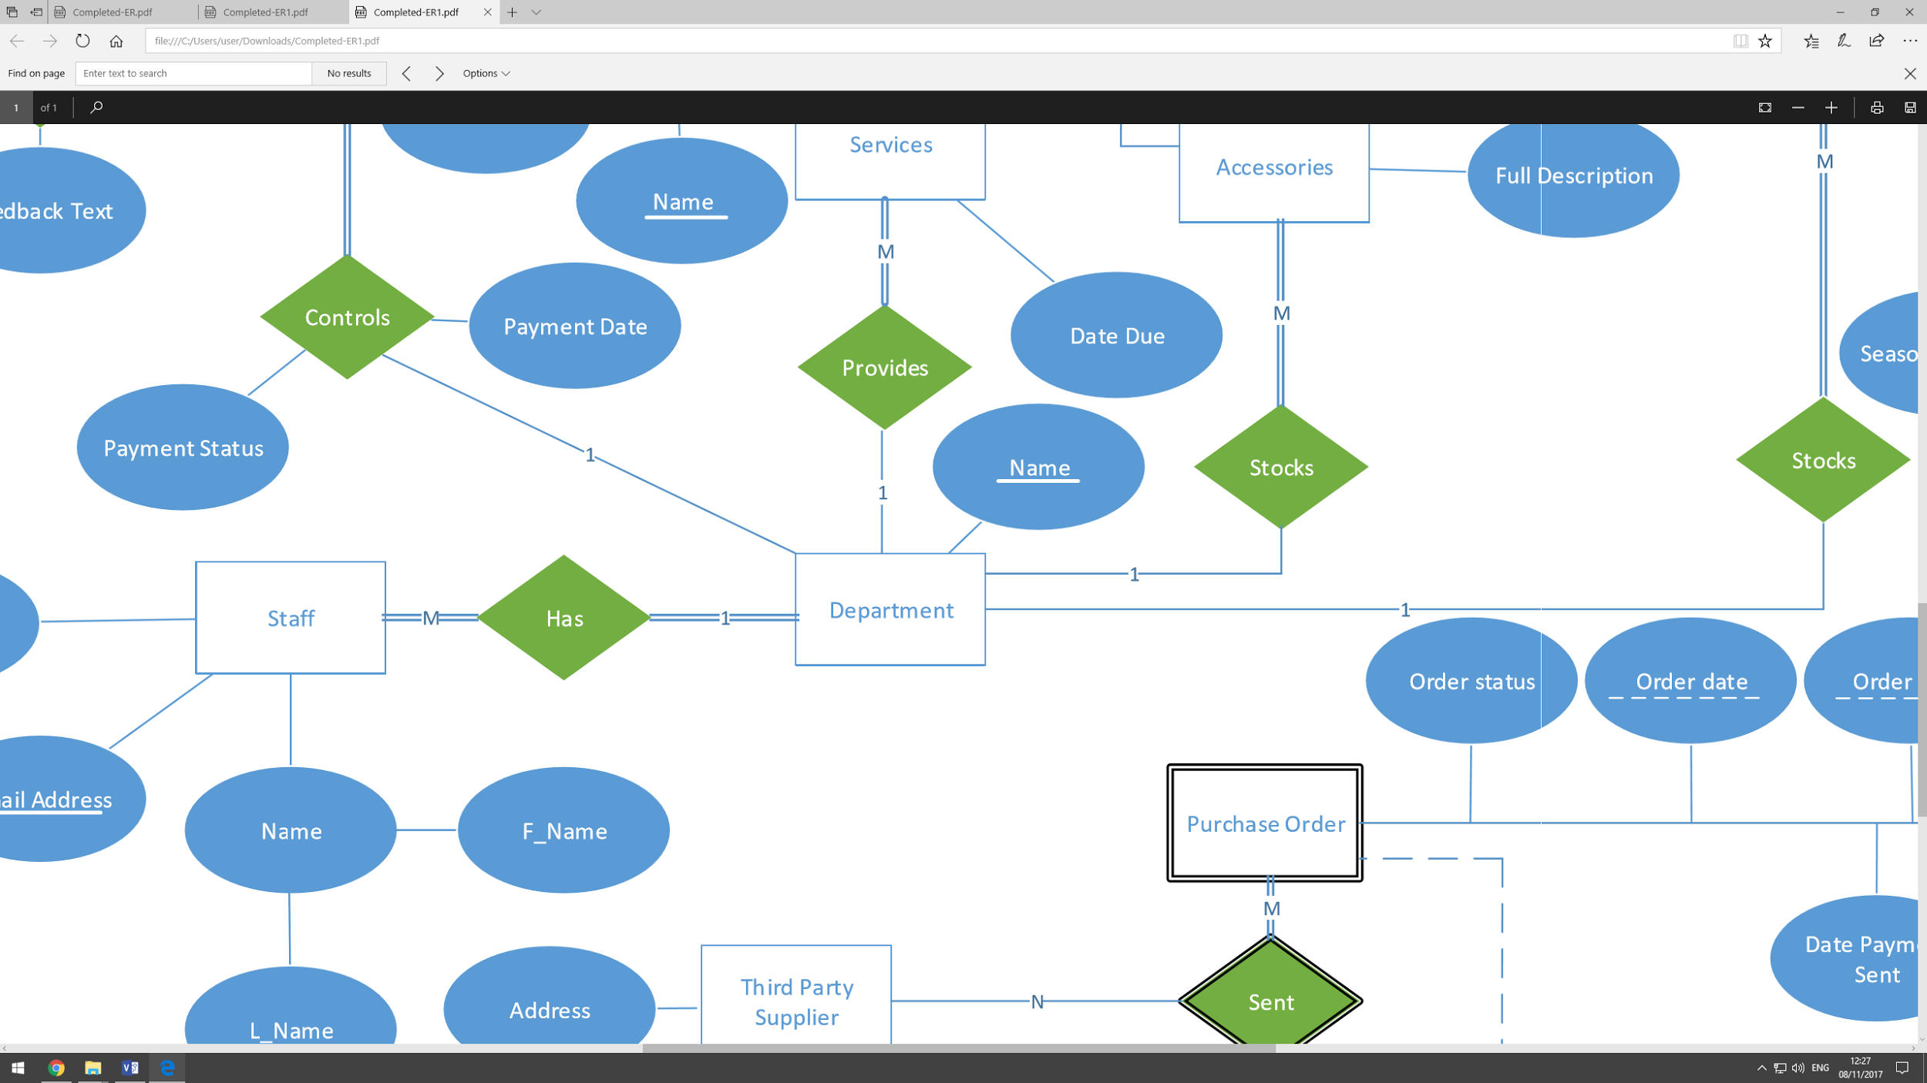
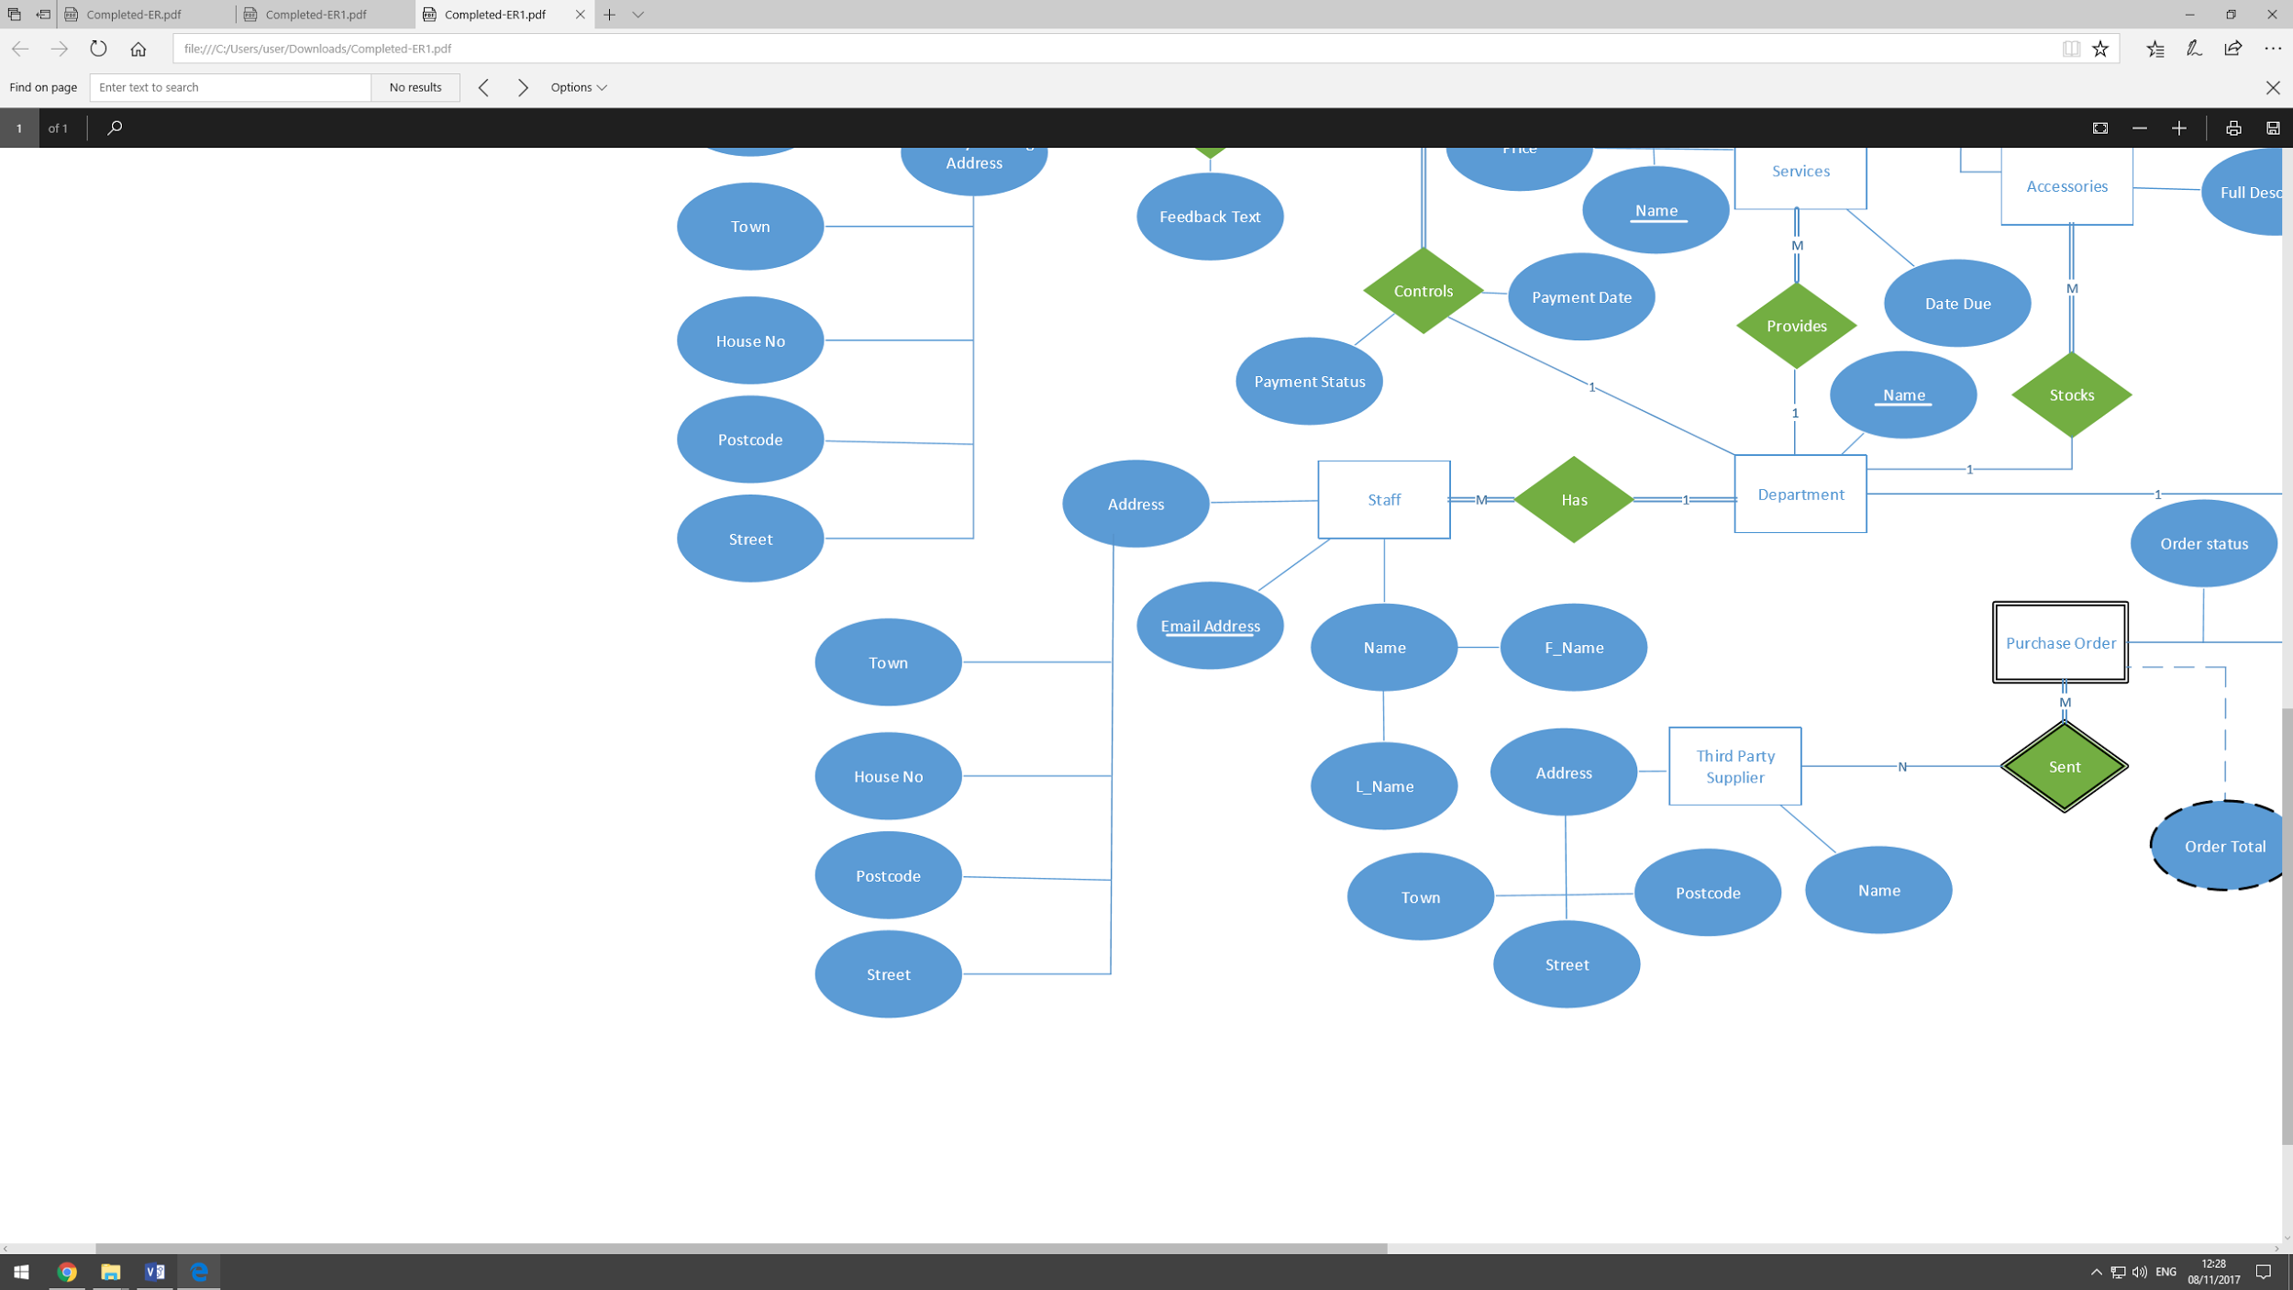
Mapping Step 1:
Mapping Of Strong Entities:
To Complete Step 1 of the mapping process, take the strong entities from the ER Diagram, along with the single, stored attributes and assign each entity a primary key.
Department: Dep_Name.
Staff: Sta_EmailAddress, Sta_ FirstName, Sta_Surname, Sta_Town,
Sta_HouseNo, Sta_PostCode, Sta_Street.

Slide 31
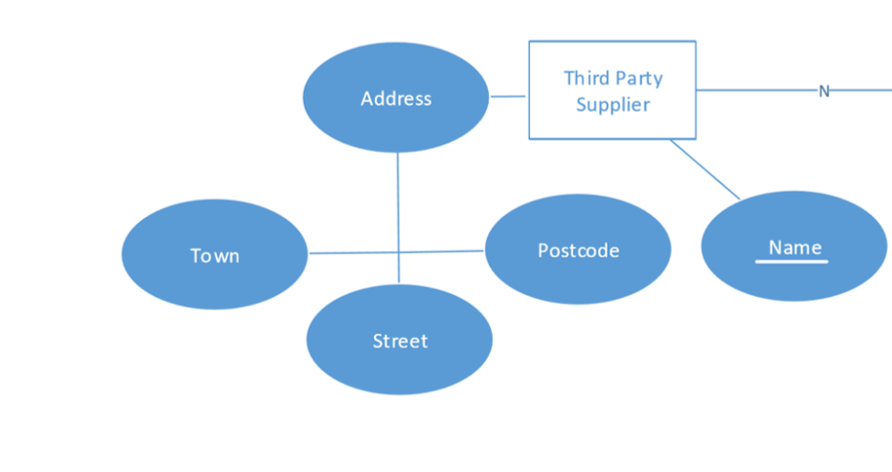
Mapping Step 1:
Mapping Of Strong Entities:
To Complete Step 1 of the mapping process, take the strong entities from the ER Diagram, along with the single, stored attributes and assign each entity a primary key.
Third Party Supplier: TPS_Name, TPS_Postcode, TPS_Town, TPS_Postcode.

Slide 32
Mapping Step 1:
Completed Mapping Of Strong Entities:
To Complete Step 1 of the mapping process, take the strong entities from the ER Diagram, along with the single, stored attributes and assign each entity a primary key.
Customer: Cus_EmailAddress, Cus_FirstName, Cus_Surname, Cus_Town, Cus_HouseNo, Cus_PostCode, Cus_Street.
Services: Ser_Name, Ser_DueDate, Ser_Price.
Accessories: Acc_Name,Acc_Price, Acc_FullDescription.
Plant: Pl_LatinName, Pl_PopularName, Pl_PlantCategory, Pl_Price, Pl_SunLight, Pl_AcidOrAlkaline, Pl_Moisture,Pl_Soil Type, Pl_FullDescription, Pl_ColorOfFoliage, Pl_ColorOfFlower, Pl_FloweringPeriod, Pl_Height, Pl_Spread, Pl_Spread.
Department: Dep_Name.
Staff: Sta_EmailAddress, Sta_ FirstName, Sta_Surname, Sta_Town, Sta_HouseNo, Sta_PostCode, Sta_Street.
Third Party Supplier: TPS_Name, TPS_Postcode, TPS_Town, TPS_Postcode.

Slide 33
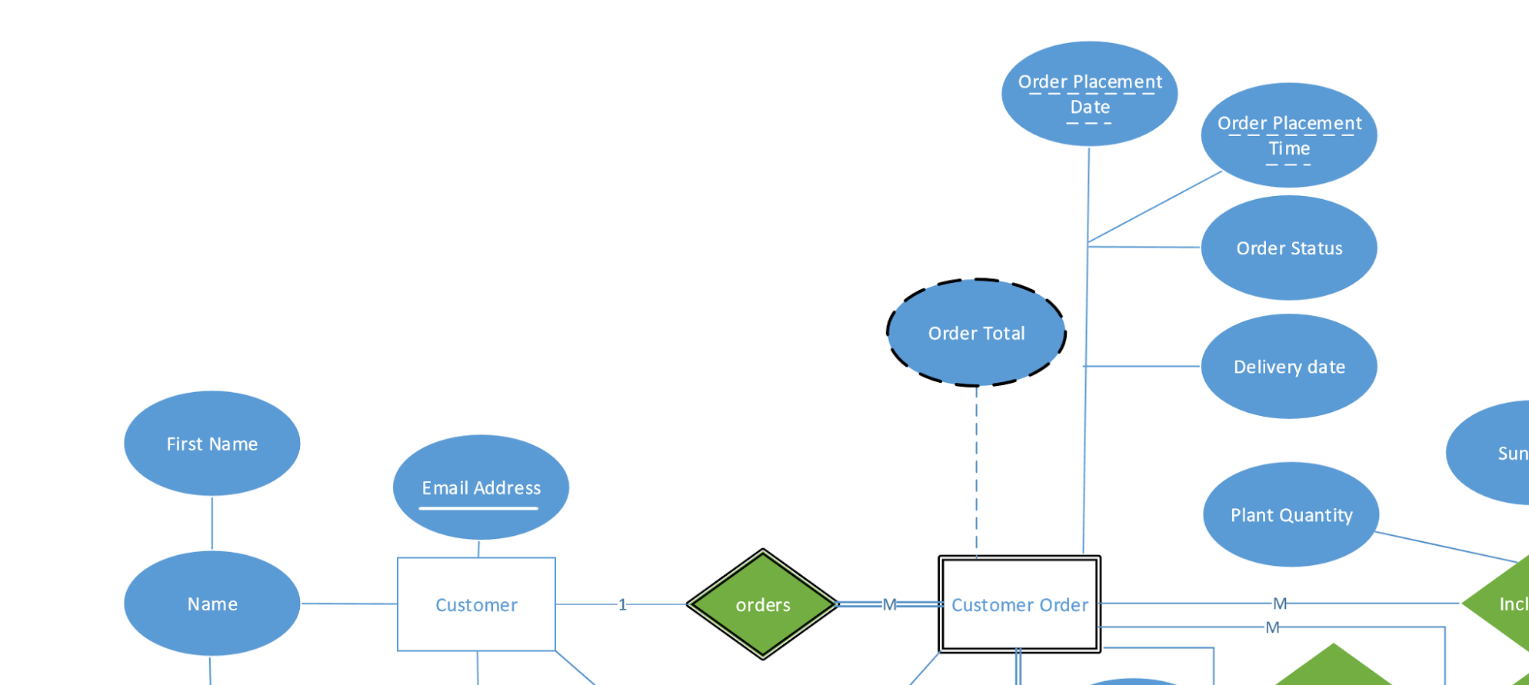
Mapping Step 2:
Mapping Of Weak Entities:
To Complete Step 2, create relations for each weak entity type, including the single and stored attributes. Include the primary key from the owner entity.
The Primary Key becomes: Owners PK + Partial Key
Customer Order: CO_OrderPlacementDate, CO_OrderPlacementTime, CO_OrderStatus, CO_ DeliveryDate, Cus_EmailAddress.

Slide 34
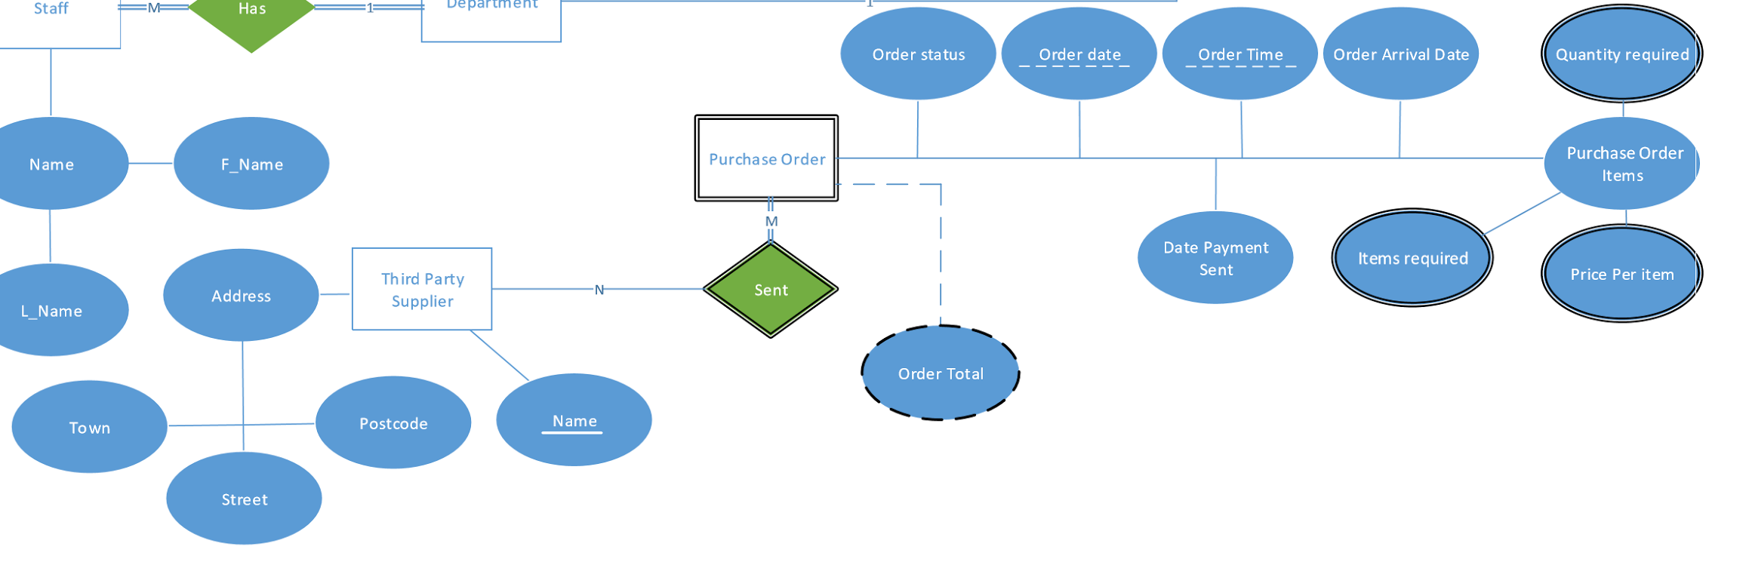
Mapping Step 2:
Mapping Of Weak Entities:
To Complete Step 2, create relations for each weak entity type, including the single and stored attributes. Include the primary key from the owner entity.
The Primary Key becomes: Owners PK + Partial Key
Purchase Order: PO_Orderdate, PO_OrderTime, PO_OrderStatus, PO_OrderArrivalDate, DatePaymentSent, TPS_Name.

Slide 35
Mapping Step 2:
Completed Mapping Of Weak Entities:
To Complete Step 2, create relations for each weak entity type, including the single and stored attributes. Include the primary key from the owner entity.
The Primary Key becomes: Owners PK + Partial Key
Customer Order: CO_OrderPlacementDate, CO_OrderPlacementTime, CO_OrderStatus, CO_ DeliveryDate, Cus_EmailAddress.
Purchase Order: PO_Orderdate, PO_OrderTime, PO_OrderStatus, PO_OrderArrivalDate, DatePaymentSent, TPS_Name

Slide 36
Mapping Step 3:
Mapping Of 1:1 Binary Type Relationship types:
To Complete Step 3,
1. Foreign Key approach for full-partial participation
2. Merged relation approach for full-full participation
3. Cross-reference relation approach for partial-partial participation
There are no 1:1 Relationships in our Entity Relationship Diagram, therefore we can skip this step.

Slide 37
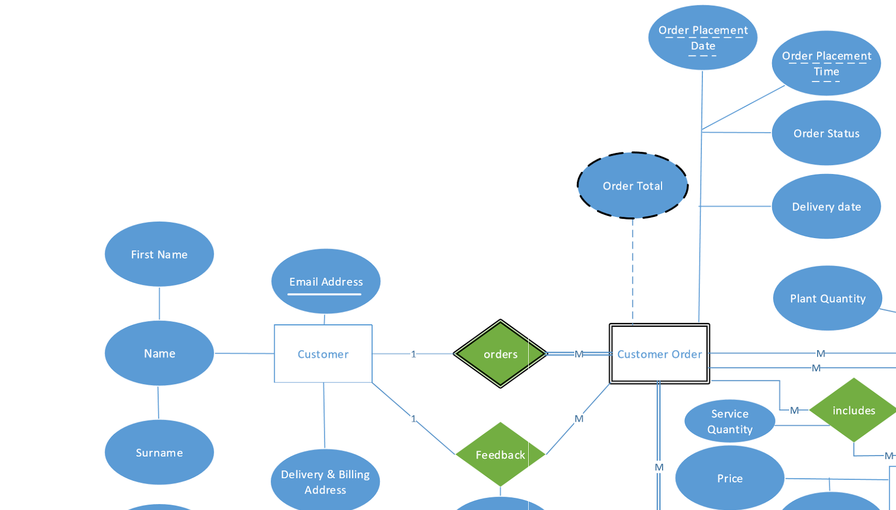
Mapping Step 4:
Mapping Of 1:M Binary Type Relationship types:
To Complete Step 4, Chose the entity which has the Many Cardinality. Then include a FK referencing of the other entity.
Mapping of Relationship Orders:
Customer Order: (CO_OrderPlacementDate,
CO_OrderPlacementTime, CO_OrderStatus,
CO_ DeliveryDate, Cus_EmailAddress.)
Mapping of Relationship Feedback:
Customer Order(CO_OrderPlacementDate, CO_OrderPlacementTime,
CO_OrderStatus, CO_ DeliveryDate, FeedbackText, Cus_EmailAddress.)

Slide 38
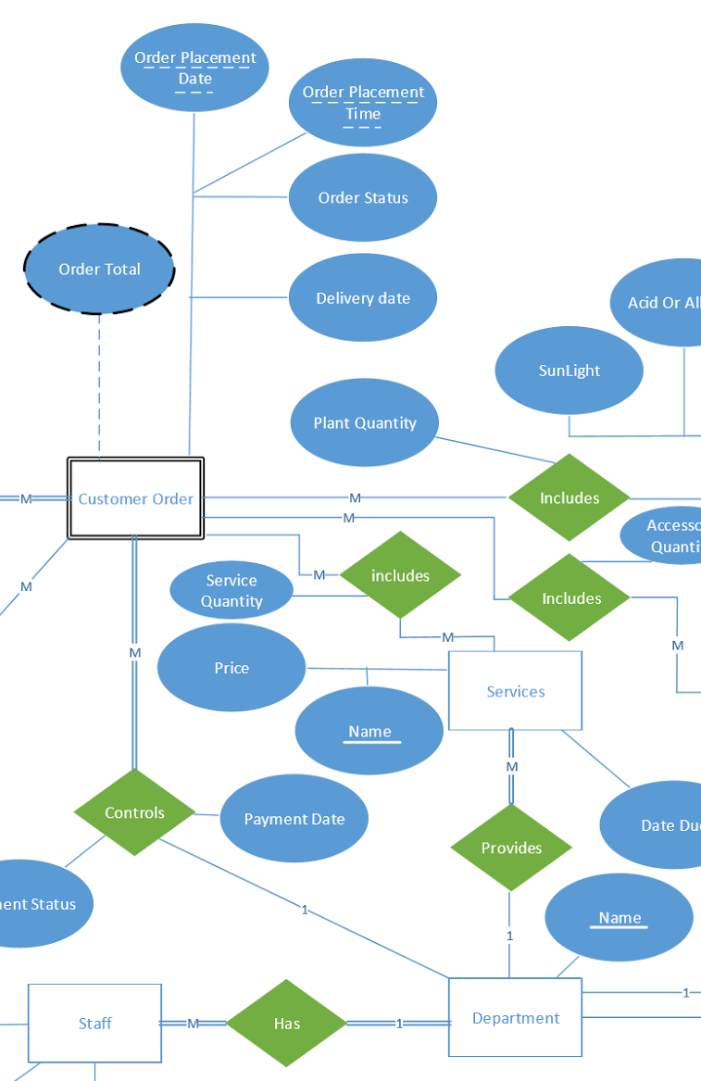
Mapping Step 4:
Mapping Of 1:M Binary Type Relationship types:
To Complete Step 4, Chose the entity which has the Many Cardinality. Then include a FK referencing of the other entity.
Mapping of Relationship Controls:
Customer Order(CO_OrderPlacementDate, CO_OrderPlacementTime,
CO_OrderStatus, CO_ DeliveryDate, Cus_EmailAddress, Dep_Name,
Payment Status, Payment Date)

Slide 39
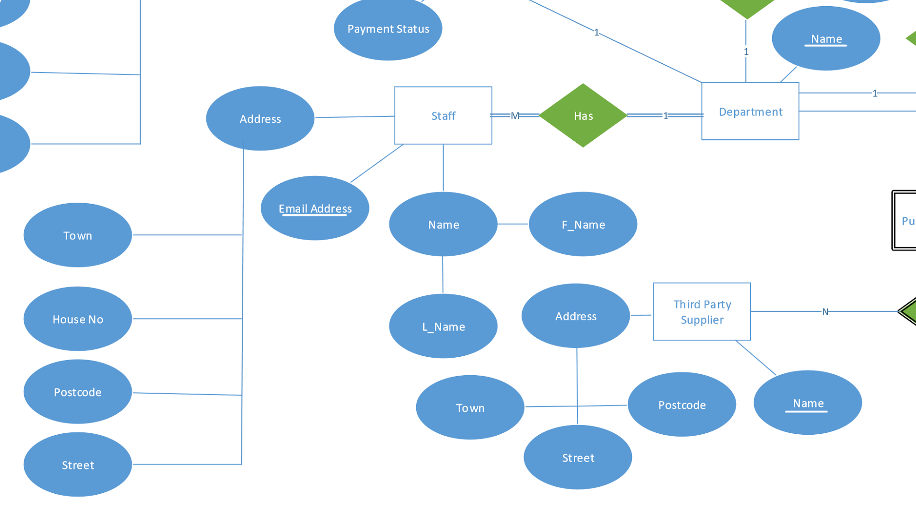
Mapping Step 4:
Mapping Of 1:M Binary Type Relationship types:
To Complete Step 4, Chose the entity which has the Many Cardinality. Then include a FK referencing of the other entity.
Mapping of Relationship Has:
Staff(Sta_EmailAddress, Sta_ FirstName, Sta_Surname, Sta_Town, Sta_HouseNo, Sta_PostCode, Sta_Street, Dep_Name)

Slide 40
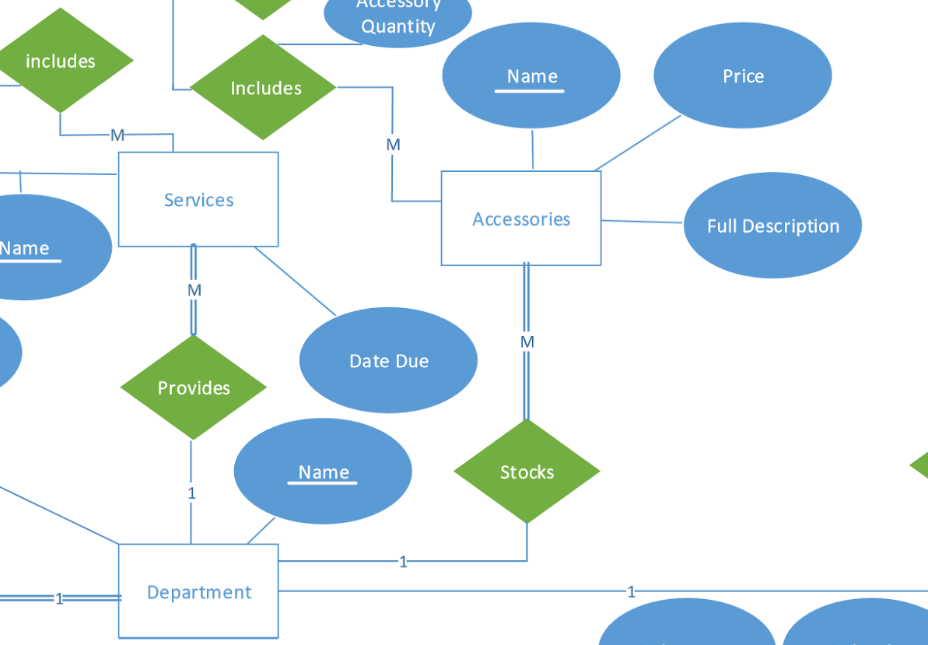
Mapping Step 4:
Mapping Of 1:M Binary Type Relationship types:
To Complete Step 4, Chose the entity which has the Many Cardinality. Then include a FK referencing of the other entity.
Mapping of Relationship Stocks (Department 1:M Accessories):
Accessories(Acc_Name,Acc_Price, Acc_FullDescription, Dep_Name)

Slide 41
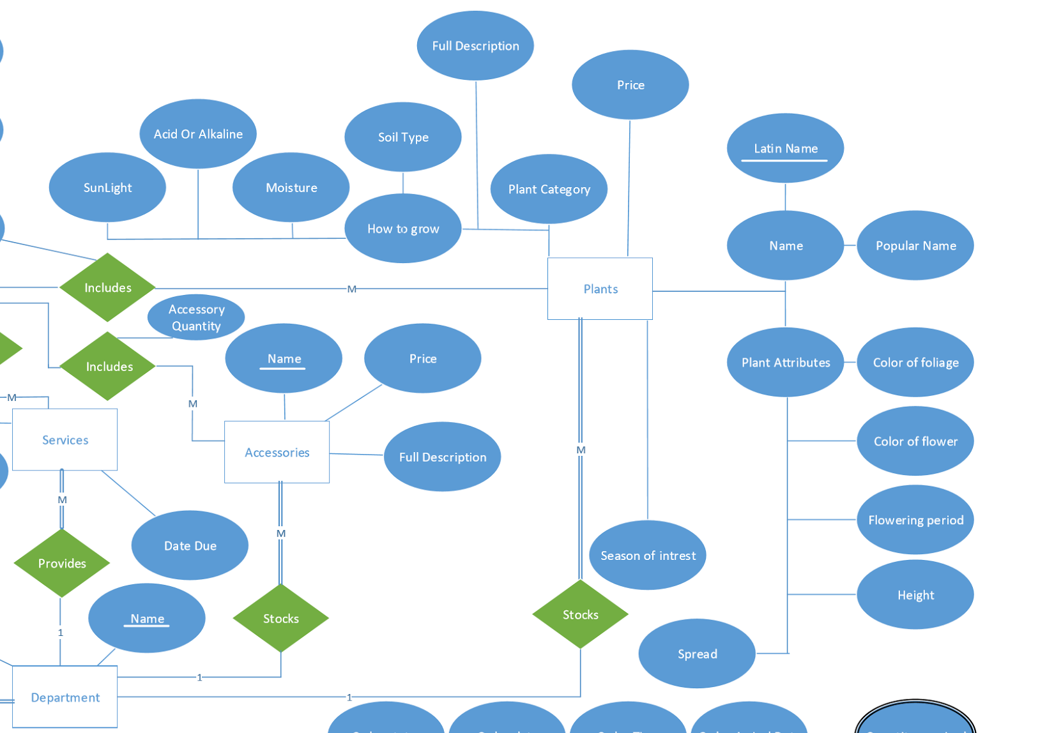
Mapping Step 4:
Mapping Of 1:M Binary Type Relationship types:
To Complete Step 4, Chose the entity which has the Many Cardinality. Then include a FK referencing of the other entity.
Mapping of Relationship Stocks ( Department 1:M Plants):
Plants(Pl_LatinName, Pl_PopularName, Pl_PlantCategory, Pl_Price, Pl_SunLight, Pl_AcidOrAlkaline, Pl_Moisture,Pl_Soil Type, Pl_FullDescription, Pl_ColorOfFoliage, Pl_ColorOfFlower, Pl_FloweringPeriod, Pl_Height, Pl_Spread, Pl_Spread, Dep_Name)

Slide 42
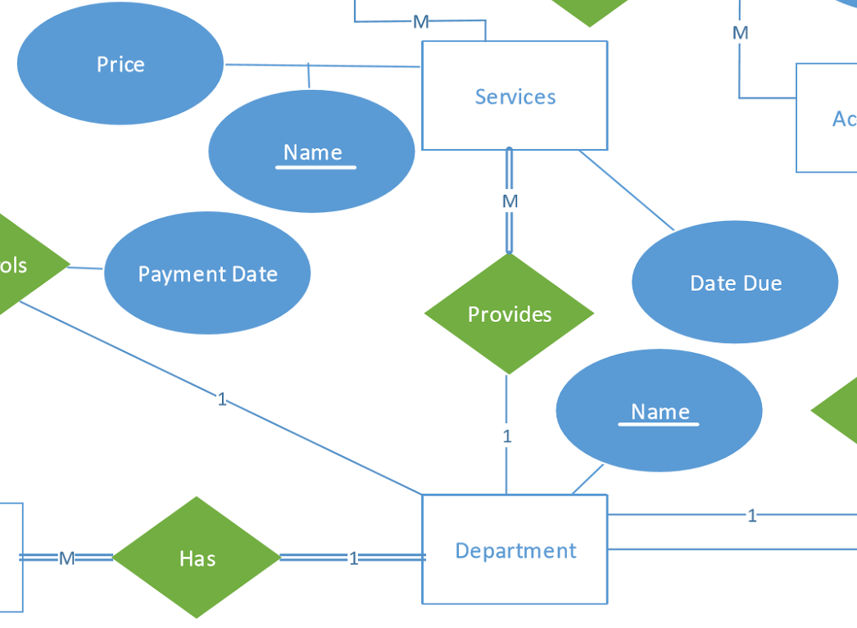
Mapping Step 4:
Mapping Of 1:M Binary Type Relationship types:
To Complete Step 4, Chose the entity which has the Many Cardinality. Then include a FK referencing of the other entity.
Mapping of Relationship Provides (Department 1:M Servies):
Services (Ser_Name, Ser_DueDate, Ser_Price, Dep_Name)

Slide 43
Mapping Step 4:
Completed Mapping Of 1:M Binary Type Relationship types:
To Complete Step 4, Chose the entity which has the Many Cardinality. Then include a FK referencing of the other entity.
Mapping of Relationship Orders:
Customer Order: (CO_OrderPlacementDate, CO_OrderPlacementTime, CO_OrderStatus, CO_ DeliveryDate, Cus_EmailAddress.)
Mapping of Relationship Feedback:
Customer Order(CO_OrderPlacementDate, CO_OrderPlacementTime, CO_OrderStatus, CO_ DeliveryDate, FeedbackText, Cus_EmailAddress.)
Mapping of Relationship Controls:
Customer Order(CO_OrderPlacementDate, CO_OrderPlacementTime, CO_OrderStatus, CO_ DeliveryDate, Cus_EmailAddress, Dep_Name, Payment Status, Payment Date)
Mapping of Relationship Has:
Staff(Sta_EmailAddress, Sta_ FirstName, Sta_Surname, Sta_Town, Staf_HouseNo, Sta_PostCode, Sta_Street, Dep_Name)

Slide 44
Mapping Step 4:
Completed Mapping Of 1:M Binary Type Relationship types:
Mapping of Relationship Stocks (Department 1:M Accessories):
Accessories(Acc_Name,Acc_Price, Acc_FullDescription, Dep_Name)
Mapping of Relationship Stocks ( Department 1:M Plants):
Plants(Pl_LatinName, Pl_PopularName, Pl_PlantCategory, Pl_Price, Pl_SunLight, Pl_AcidOrAlkaline, Pl_Moisture,Pl_Soil Type, Pl_FullDescription, Pl_ColorOfFoliage, Pl_ColorOfFlower, Pl_FloweringPeriod, Pl_Height, Pl_Spread, Pl_Spread, Dep_Name)
Mapping of Relationship Provides (Department 1:M Servies):
Servies (Ser_Name, Ser_DueDate, Ser_Price, Dep_Name)
To Complete Step 4, Chose the entity which has the Many Cardinality. Then include a FK referencing of the other entity.

Slide 45
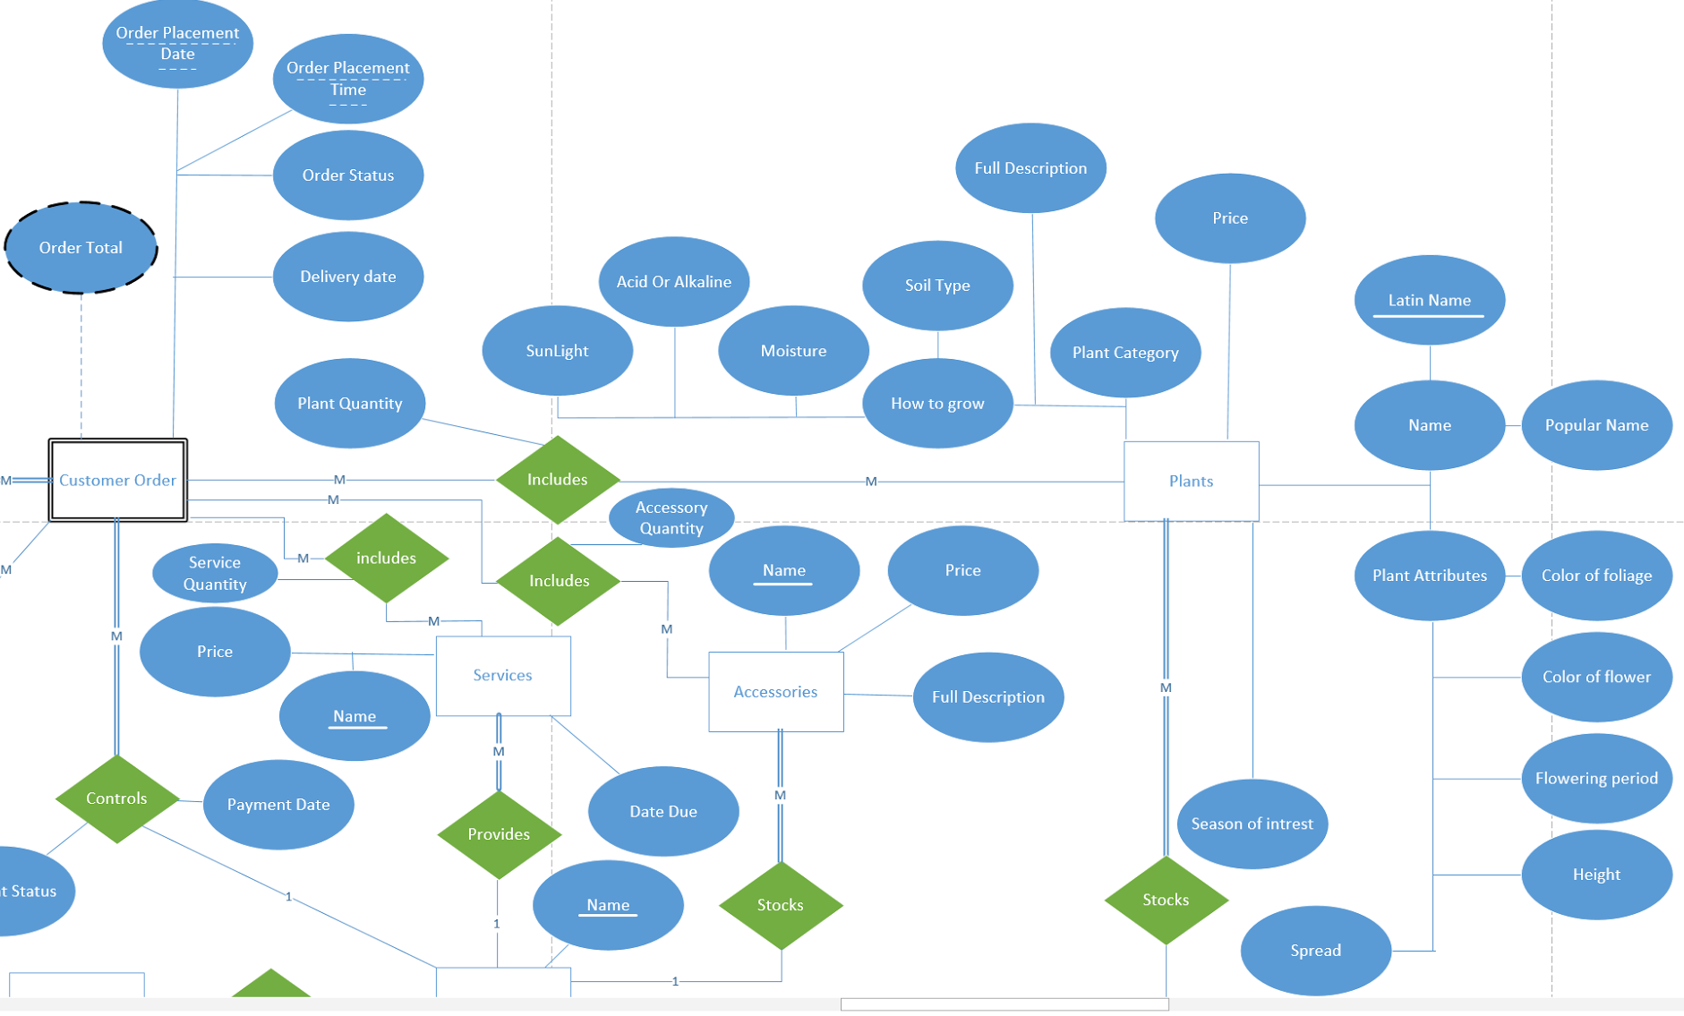
Mapping Step 5:
Mapping Of M:N Binary Type Relationship types:
Mapping of Relationship Includes: (Customer Order M:N Plants)
This relationship table will show how many plants have been ordered, therefore renaming the relationship to Plants Ordered from includes.
Plants Ordered (CO_OrderPlacementDate, CO_OrderPlacementTime, Cus_EmailAddress, Pl _Latin Name, Quantity)

Slide 46
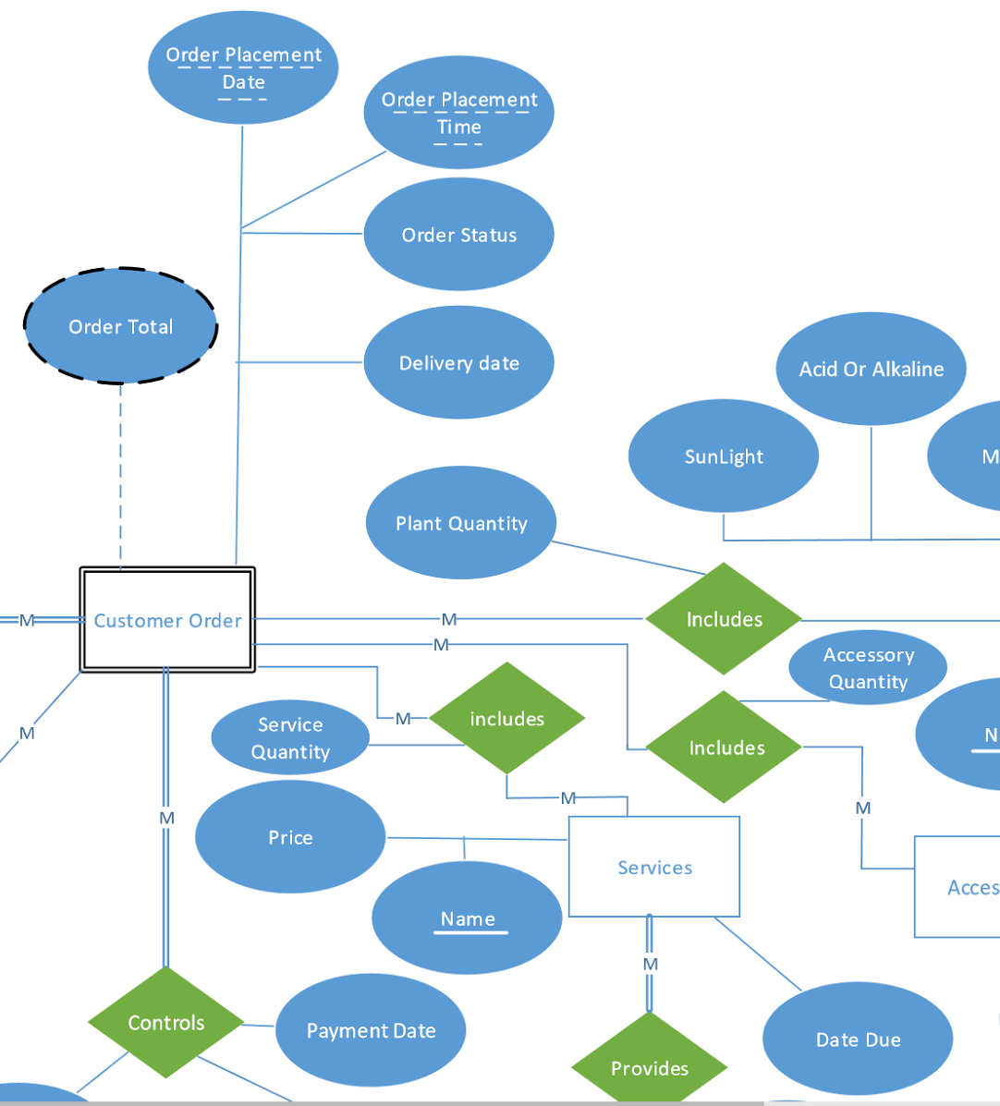
Mapping Step 5:
Mapping Of M:N Binary Type Relationship types:
Mapping of Relationship Includes: (Customer Order M:N Services )
This relationship table will show how many Services have been ordered, therefore renaming the relationship to Service Ordered from includes.
Services Ordered (CO_OrderPlacementDate, CO_OrderPlacementTime,
Cus_EmailAddress, Ser_Name, Quantity)

Slide 47

Mapping Step 5:
Mapping Of M:N Binary Type Relationship types:
Mapping of Relationship Includes: (Customer Order M:N Accessories )
This relationship table will show how many Accessories have been ordered, therefore renaming the relationship to Accessories Ordered.
Accessories Ordered (CO_OrderPlacementDate, CO_OrderPlacementTime, Cus_EmailAddress, Acc_Name, Quantity)

Slide 48
Mapping Step 5:
Completed Mapping Of M:N Binary Type Relationship types:
Mapping of Relationship Includes: (Customer Order M:N Plants)
This relationship table will show how many plants have been ordered, therefore renaming the relationship to Plants Ordered.
Plants Ordered (CO_OrderPlacementDate, CO_OrderPlacementTime, Cus_EmailAddress, Pl _Latin Name, Quantity)
Mapping of Relationship Includes: (Customer Order M:N Services )
This relationship table will show how many Services have been ordered, therefore renaming the relationship to Service Ordered.
Services Ordered (CO_OrderPlacementDate, CO_OrderPlacementTime, Cus_EmailAddress, Ser_Name, Quantity)
Mapping of Relationship Includes: (Customer Order M:N Accessories )
This relationship table will show how many Accessories have been ordered, therefore renaming the relationship to Accessories Ordered.
Accessories Ordered (CO_OrderPlacementDate, CO_OrderPlacementTime, Cus_EmailAddress, Acc_Name, Quantity)

Slide 49
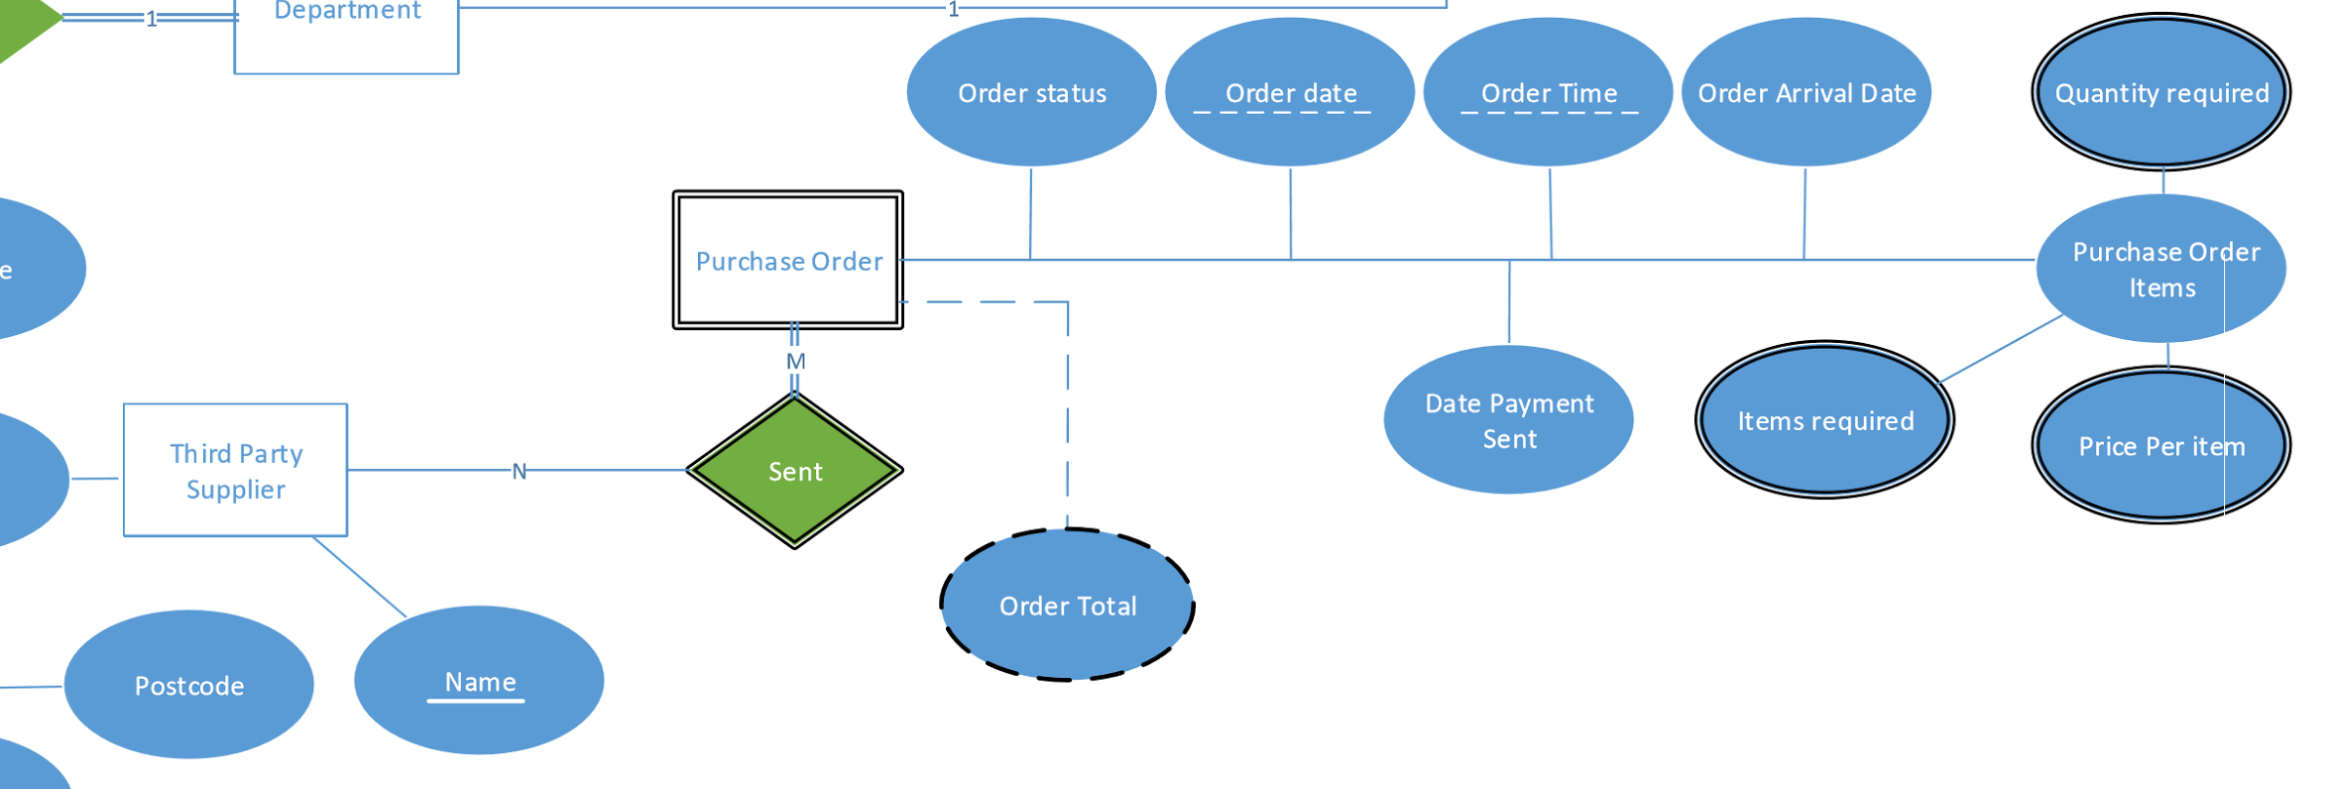
Mapping Step 6:
Mapping Of Multivalued Attributes:
Mapping of Purchase Order Items:
There are 3 multi valued attributes that need to be grouped together. These are the items quantity, items required and Price Per Item. They were multi valued attributes because purchase orders usually contain more than one type of item.
Purchase Order Items(PO_Orderdate, PO_OrderTime,TPS_Name, Item Required, Item Quantity, Price Per Item)

Slide 50
Mapping Step 7:
Mapping Of N-ary Relationship
Not applicable.

Slide 51
Relations- Mapping Completed
Customer: (Cus_EmailAddress, Cus_FirstName, Cus_Surname, Cus_Town, Cus_HouseNo, Cus_PostCode, Cus_Street)
Services: (Ser_Name, Ser_DueDate, Ser_Price, Dep_Name)
Accessories: (Acc_Name,Acc_Price, Acc_FullDescription, Dep_Name)
Plant: (Pl_LatinName, Pl_PopularName, Pl_PlantCategory, Pl_Price, Pl_SunLight, Pl_AcidOrAlkaline, Pl_Moisture,Pl_Soil Type, Pl_FullDescription, Pl_ColorOfFoliage, Pl_ColorOfFlower, Pl_FloweringPeriod, Pl_Height, Pl_Spread, Pl_Spread, Dep_Name)
Department: (Dep_Name.)
Staff: (Sta_EmailAddress, Sta_ FirstName, Sta_Surname, Sta_Town, Sta_HouseNo, Sta_PostCode, Sta_Street, Dep_Name)
Third Party Supplier: (TPS_Name, TPS_Postcode, TPS_Town, TPS_Postcode.)
Customer Order: (CO_OrderPlacementDate, CO_OrderPlacementTime, CO_OrderStatus, CO_ DeliveryDate,
FeedbackText, Dep_Name, Payment Status, Payment Date, Cus_EmailAddress.)
Purchase Order: (PO_Orderdate, PO_OrderTime, PO_OrderStatus, PO_OrderArrivalDate, DatePaymentSent, TPS_Name)
Plants Ordered (CO_OrderPlacementDate, CO_OrderPlacementTime, Cus_EmailAddress, Pl _Latin Name, Quantity)
Servies Ordered (CO_OrderPlacementDate, CO_OrderPlacementTime, Cus_EmailAddress, Ser_Name, Quantity)
Accessories Ordered (CO_OrderPlacementDate, CO_OrderPlacementTime, Cus_EmailAddress, Acc_Name, Quantity)
Purchase Order Items(PO_Orderdate, PO_OrderTime,TPS_Name, Items Required, Items Quantity, Price Per Item)

Slide 52
Functional Dependencies

Slide 53
Functional Dependencies
Plant-Detail: ​
{Customer-Name (CustomerFirstname, Customer-Lastname), Customer-Email, Customer-Address (House-No/Name, Post-Code, City, County, Country), Customer-Age, Customer-Order Date/time, Staff-Name (Staff-Firstname, staff-Lastname), Staff-Email, {StaffQualifications}, Item-Type, Item-Description, Item-Name, Item-Price, Discount, Quantity, Item-Total-Price, Order-Total-Price}.​
Candidate keys :
{Customer Email, Customer-Order Date/time, Item-Name} ​
{Staff-Email}
Prime attributes are: ​
{Customer Email, Customer-Order Date/time, Item-Name, Staff-email}​
Non-Prime attributes are: ​
{Customer-Name (CustomerFirstname, Customer-Lastname), Customer-Address (House-No/Name, Post-Code, City, County, Country), Customer-Age, Staff-Name (Staff-Firstname, staff-Lastname), {StaffQualifications}, Item-Type, Item-Description, Item-Price, Discount, Quantity, Item-Total-Price, Order-Total-Price}​
​
Notes:
Functional Dependencies
In order to approach the function dependencies we divided up the plant-detail relation into 3 parts - shown by the colours.
Each part represents a different set of data, these are : Customer Information, Staff Information and Item Information
These were then broken into the candidate keys shown - the prime and non-prime attributes are also shown below.
NEXT SLIDE

Slide 54
Questions with Answers
I. Identify two candidate keys then choose a primary key?
{Customer Email, Customer-Order Date/time, Item-Name} ​
{Staff-Email}
II. Identify four functional dependencies in the Plant-Detail relation?
FD1: Customer-Email → {Customer-Name, Customer-Address, Customer-Age}
FD2: Item-Name → {Item-Description, Item-Type, Item-Price, Discount}
FD3: Staff-Email → {Staff-Name, Staff-Qualifications}
FD4: {Customer-Email, Customer-Order Date/time, Item-Name} → {Quantity}
Notes:
To answer the questions, a primary key was then chosen, “Customer Email, Order Data and Time and Item Name” seemed a logical choice as it was both minimal and can be uniquely used to find to identify a database record.
We then worked through the process of determining the functional dependencies, four of which are shown below to answer the question in the brief.
NEXT SLIDE

Slide 55
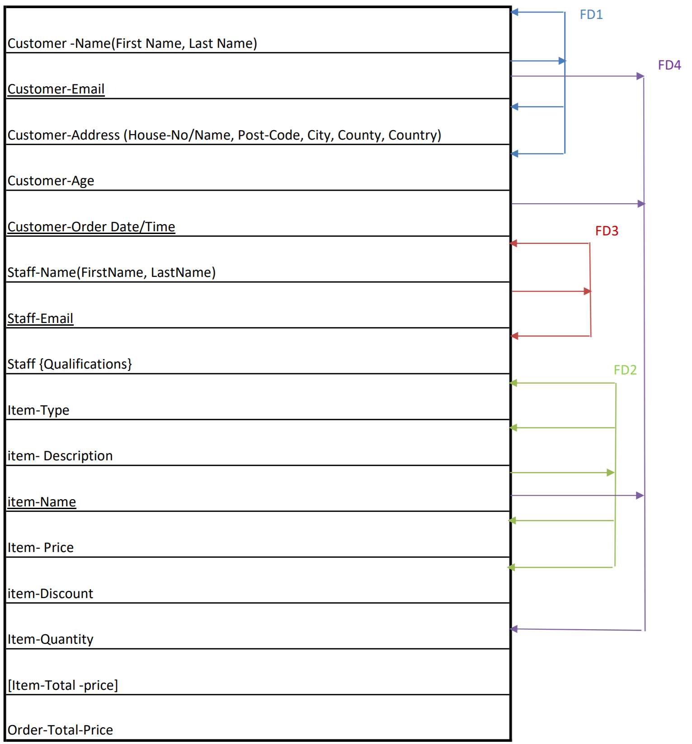
Notes:
This diagram shows all 4 functional dependencies within the plant-detail relation mapped.

Slide 56
Normalisation of the Plant-Detail Relation

Slide 57
Normalisation of Plant-Detail Relation
{Customer-Name (CustomerFirstname, Customer-Lastname), Customer-Email, Customer-Address (House-No/Name, Post-Code, City, County, Country), Customer-Age, Customer-Order Date/time, Staff-Name (Staff-Firstname, staff-Lastname), Staff-Email, {StaffQualifications}, Item-Type, Item-Description, Item-Name, Item-Price, Discount, Quantity, Item-Total-Price, Order-Total-Price}.​

Slide 58
Normalisation to the First Normal Form (1NF)
{Customer-Name, Customer-Email, Customer-Address, Customer-Age, Customer-Order Date/time, Staff-Name, Staff-Email, {StaffQualifications}, Item-Type, Item-Description, Item-Name, Item-Price, Discount, Quantity, Item-Total-Price, Order-Total-Price}.​
Problematic Attributes
Customer-Name
Customer-Address
Staff-Name
Staff-Qualifications
Attribute Key Simple
Composite
Derived
Multi-valued

Slide 59
Normalisation to the First Normal Form (1NF)
Functional Dependencies
FD1: Customer-Email → {Customer-Name, Customer-Address, Customer-Age}
FD2: Item-Name → {Item-Description, Item-Type, Item-Price, Discount}
FD3: Staff-Email → {Staff-Name, Staff-Qualifications}
FD4: {Customer-Email, Customer-Order Date/time, Item-Name} → {Quantity}
Customer-Name can be normalised using atomic attributes
Customer-Address can be normalised using atomic attributes
Staff-Name can be normalised using atomic attributes
Staff-Qualifications can be normalised by decomposing into a separate relation
Attribute Key Simple
Composite
Derived
Multi-valued

Slide 60
Normalisation to the First Normal Form (1NF)
Customer-Name has been decomposed into two atomic attributes (Customer-FirstName and Customer-LastName)
Customer-Address has been decomposed into five atomic attributes (House-No/Name, Post-Code, City, County and Country)
{Customer-Email, CustomerFirstname, Customer-Lastname, House-No/Name, Post-Code, City, County, Country, Customer-Age, Customer-Order Date/time, Item-Type, Item-Description, Item-Name, Item-Price, Discount, Quantity, Item-Total-Price, Order-Total-Price}.​
Staff-Name has been decomposed into two atomic attributes (Staff-Firstname and Staff-Lastname)
{Staff-Email, Staff-Firstname, Staff-Lastname}
A separate relation has been created in order to deal with the problematic StaffQualifications multi-valued attribute
{Staff-Email, StaffQualifications}

Slide 61
Normalisation to the Second Normal Form (2NF)
Customer
{Customer-Email, CustomerFirstname, Customer-Lastname, House-No/Name, Post-Code, City, County, Country, Customer-Age}
Staff {Staff-Email, Staff-Firstname, Staff-Lastname}
Staff Qualifications
{Staff-Email, StaffQualifications}
Order
{Customer-Email, Customer-Order Date/time, Item-Name, Quantity, Item-Total-Price, Order-Total-Price}
Item {Item-Name, Item-Type, Item-Description, Item-Price, Discount}
“FD1: Customer-Email → {Customer-Name, Customer-Address, Customer-Age}
FD2: Item-Name → {Item-Description, Item-Type, Item-Price, Discount}
FD3: Staff-Email → {Staff-Name, Staff-Qualifications}
FD4: {Customer-Email, Customer-Order Date/time, Item-Name} → {Quantity}”

Slide 62
Normalisation to the Third Normal Form (3NF)
Customer
{Customer-Email, CustomerFirstname, Customer-Lastname, House-No/Name, Post-Code, City, County, Country, Customer-Age} ✘
Staff {Staff-Email, Staff-Firstname, Staff-Lastname} ✓
Staff Qualifications
{Staff-Email, StaffQualifications} ✓
Order
{Customer-Email, Customer-Order Date/time, Item-Name, Quantity, Item-Total-Price, Order-Total-Price} ✓
Item {Item-Name, Item-Type, Item-Description, Item-Price, Discount} ✓

Slide 63
Normalisation to the Third Normal Form (3NF)
Customer
{Customer-Email, CustomerFirstname, Customer-Lastname, House-No/Name, Post-Code, City, County, Country, Customer-Age} ✘
There is a transitive dependency between Post-Code and House-No/Name, City and County. This however, isn’t true for Country.
Customer
{Customer-Email, CustomerFirstname, Customer-Lastname, Customer-Age, Post-Code, Country}
Address
{Post-Code, House-No/Name, City, County}

Slide 64
Relations Normalised to the Third Normal Form
Customer
{Customer-Email, CustomerFirstname, Customer-Lastname, Customer-Age, Post-Code, Country}
Address
{Post-Code, House-No/Name, City, County}
Staff {Staff-Email, Staff-Firstname, Staff-Lastname}
Staff Qualifications
{Staff-Email, StaffQualifications}
Order
{Customer-Email, Customer-Order Date/time, Item-Name, Quantity, Item-Total-Price, Order-Total-Price}
Item {Item-Name, Item-Type, Item-Description, Item-Price, Discount}

Slide 65
Thank You for Watching

